Slide 1
Veni - A Check-In Mobile App for Veterans
UTD EMSE Spring 2015
April 22nd Class Meeting Report
Anant Kambli Brian MacKay Raleigh Murráy Shahed Shuman Kathryn Whitmire

Slide 2
The Physical Architecture
Linux Virtual Machine
Veni-Specific VistA Instance
Remoting
Virtual Machine
Web Service
REST - via HTTPS
with JSON or XML
iOS
Android
Intel, Xamarin or Apache Cordova

Slide 3
High Level Architecture
The high-level architecture remains
A VistA system (or systems)
We’ll set up a dev-sandboxed one in a cloud VM for this project
A middle tier web-service application running in a cloud VM
A phone application that includes logic and UI but no data
We are using a “write once – target all” development environment
The phone app will use the phone’s location services and calendar
See System Architecture Document
Package layer diagram, component diagram, top level class diagram

Slide 4
Primary Use Case: Check-in at VA Facility
<<include>>
<<include>>

Slide 5
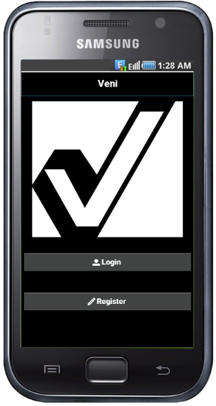
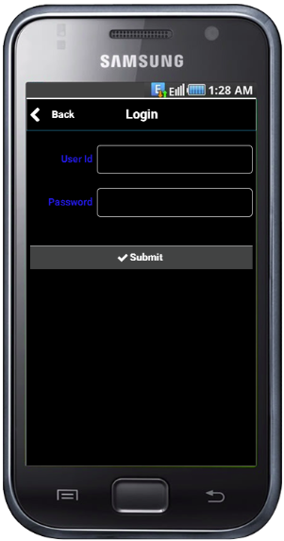
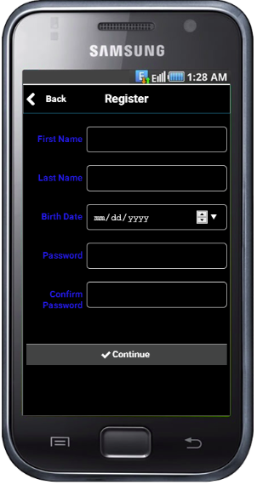
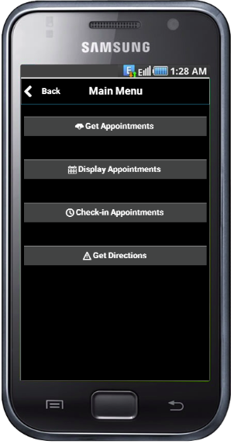
Phone UI Prototype
Splash Screen
Logon Screen
Register User
Main Menu

Slide 6
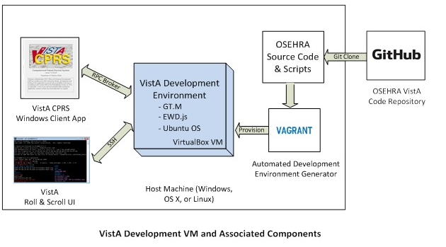
Setting Up Dev-Sandboxed VistA System
Using directions from: http://www.osehra.org/content/how-setup-osehra-vista-development-virtual-machine-vm-0

